Slide 1
Pensell
Anas Einea Omar Einea Basel Shublaq Abdulahi Osoble
U14111377 U14111378 U14112207 U14110183

Slide 2
What It Is About
We are recreating a previous project that was made using JavaScript & Firebase.
The website is an E-Commerce website that sells stuff.

Slide 3
What It Does
This website has user authentication to keep a balance & shopping cart information.
The registered users can buy items that is stored in a database.
The user can filter items based on tags.

Slide 4
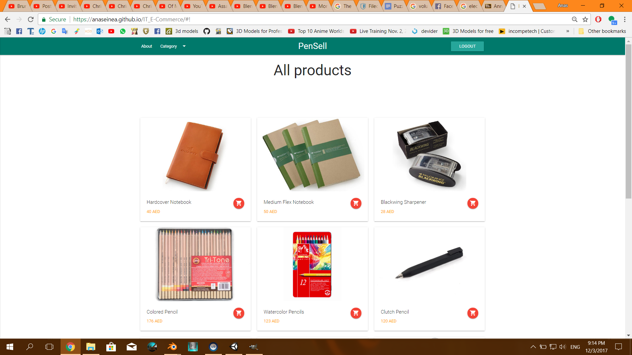
It Looks Like This

Slide 5
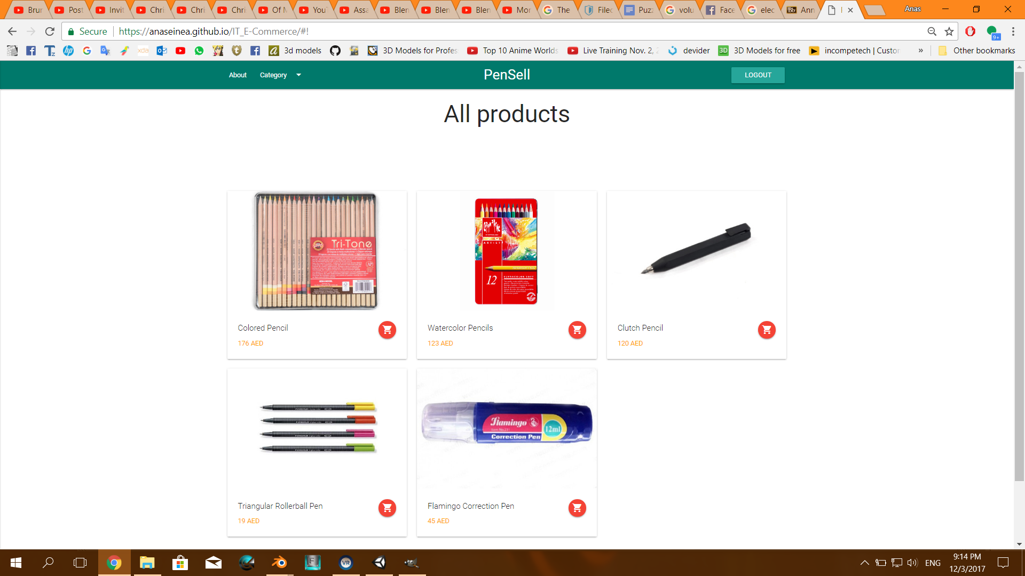
Tags Filtering

Slide 6
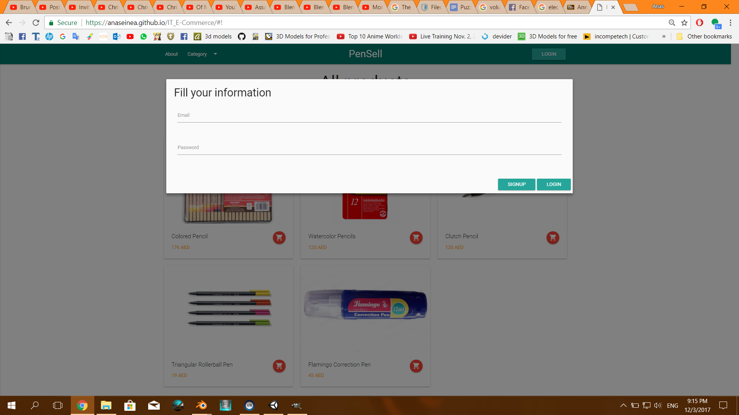
Authentication

Slide 7
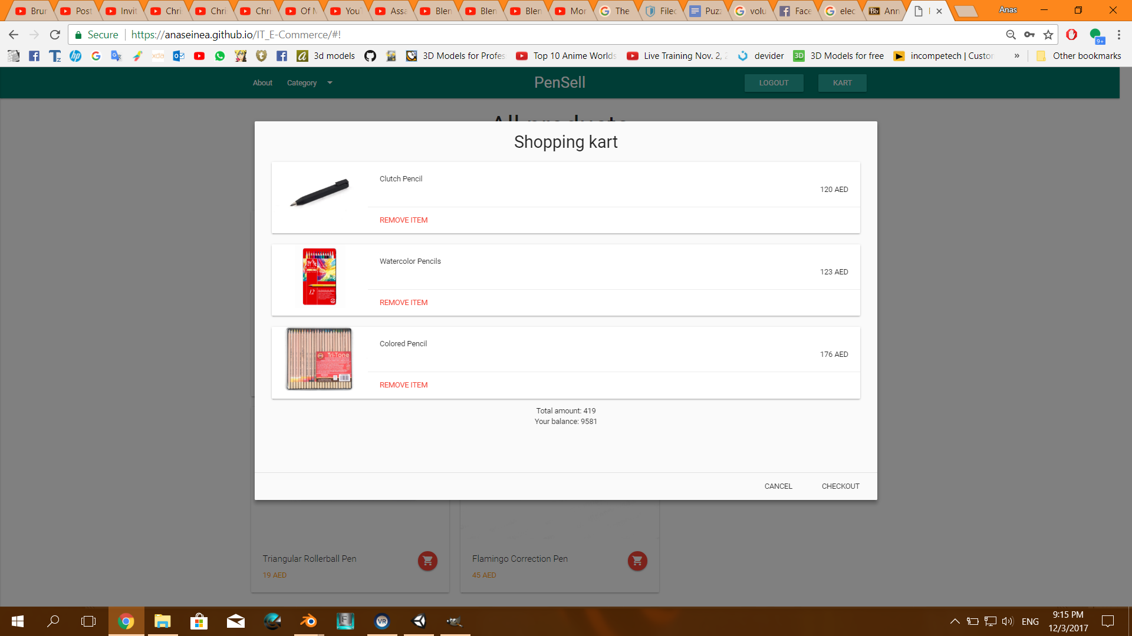
Shopping Cart

